Slide 1
Medicinal plants containing glycosides

Slide 2
Glycosides
Glycosides, or sugar ethers, are a complex grouping of aldehydes and alcohols which can be broken down to yield one or more sugars (glycones), plus a non-sugar component (aglycones).
It is important to note that glycosides are not a major classification of phytochemicals, however it is often when a phytochemical is in its glycosidic form that a constituent may have a specific therapeutic action.

Slide 3
The formation of a glycoside is dependent on interaction with Carbon, Sulphur, Nitrogen, or alcohol/phenol components. Given this, glycosides can occur in any of the major phytochemical classifications, because a sugar ether can bind itself to molecules in myriad of ways.
Glycosides are most commonly classified according to the chemical nature of the aglycone, and have vast medicinal applications as they are found in almost every therapeutic class (example: cardiac glycosides or anthraquinone glycosides).

Slide 4
Some glycosidic categories are as follows:
Alcohol
Aldehyde
Anthraquinone
Cardiac
Cyanogenic
Flavonoid
Isothiocyanate
Iridoid
Lactone
Phenol (eg. Salicin)
Saponin

Slide 5
Cardioactive glycosides
In general cardioactive glycosides improve the efficiency of the heart muscle without increasing its need for oxygen. This enables the heart to pump adequate amounts of blood around the body and ensures that no fluid builds up in the lungs or extremities.
.

Slide 6
These powerful and fascinating constituents are found in various medicinal plants, specifically cardiac glycosides such as digitoxin and convallotoxin have a strong, direct action on the heart, supporting the rate of contraction when it is failing. They are also significantly diuretic, helping to stimulate urine production, thus increasing the removal of fluid from the tissues and circulatory system.

Slide 7
Cardiac glycosides are generally used to treat cardiac insufficiency, especially in atrial fibrillation & supra ventricular rhythm abnormalities, improving the ability of the myocardium (heart muscle) to perform it’s work. When taken internally they increase force of systole and the contraction of the myocardium, having a positive inotropic effect (increased force of contraction of the heart), a negative chronotropic effect (slowing the heart rate & reducing conduction velocity at the AV junction), increasing venous return, decreasing vasoconstriction and resistance to ventricular ejection, and increasing cardiac output overall without raising myocardial oxygen requirements.

Slide 8
At the cellular level, cardiac glycosides act on the cell membrane to inhibit sodium/potassium ATPase, resulting in an increase in intracellular calcium concentrations, thereby allowing for the greater force of heart muscle contraction. In addition there is a reduced activation of the renin-angiotensin-aldosterone system and a lower circulating level of catecholamines, thereby lowering blood pressure in the vasculature overall.

Slide 9
The use of herbs rich in cardiac glycosides requires extreme caution, as they have a narrow margin of safety and at higher doses can cause nausea, vomiting, diarrhea, yellowing of vision, confusion, headache, arrhythmia, ventricular extra systole, bradycardia. The solubility and removal rates of these glycosides tends to be low, and high levels may easily accrue in the body becoming potentially quite dangerous. Their use requires frequent monitoring of diuresis, blood pressure, heart rate and serum potassium levels.

Slide 10
Drugs that reduce potassium levels in the blood (eg. diuretics, laxatives, corticosteroids, some antibiotics) increase the potency and potential toxicity of cardiac glycosides. Contraindications with concurrent drug use include: phenobarbitol, quinine, sulfasalazine, verapamil, amiodarone.

Slide 11
Herbal examples:
Digitalis purpurea (Foxglove)
Convallaria majalis (Lily of the Valley)
Asclepias tuberosa
Urginea maritime (Squill)
Note: In a strictly technical sense, the pharmacological term cardiotonic is synonymous with “positive inotropic”, and is used not only to describe agents that increase heart contractility, but also to indicate an increase in heart beat frequency and general cardiac performance. Specifically cardioactive plants are those that owe their effects on the heart to cardiac glycosides, thus possessing the strengths and drawbacks of these constituents.

Slide 12
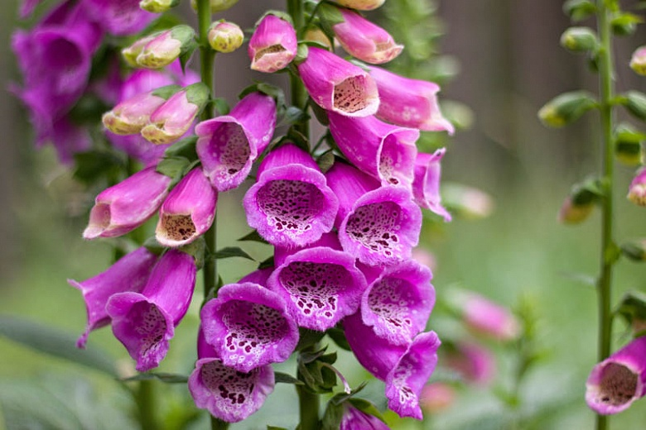
Digitalis purpurea
Common name: Foxglove
Family: Scrophulariaceae
Part Used: Leaves

Slide 13
Constituents:
Digitoxin, digoxin, and gitoxin are the most important. Digoxin is refined commercially as the drug Digoxin (Lanoxin).
Medicinal actions: Cardio-stimulant
Medicinal use: Congestive heart failure.

Slide 14
Pharmacy:
Dosage ranges of allopathic digoxin are variable according to the degree of heart failure and the age of the patient. The typical dosage range is 12 – 35 mcg/kg body weight. The maintenance daily dosage for most patients is between 0.25-0.5 mg once daily. The whole Digitalis plant or plant extracts are no longer used.

Slide 15
Toxicity:
Toxicity symptoms develop several hours after ingestion. At first the pulse slows dramatically and upon standing will become erratic and rapid. There is nausea, anxiety, salivation, constriction in the head, dizziness, disordered vision, mental disturbance, vomiting. Persons may remain in this state for several days and may or may not survive. A known antidote to digitalis poisoning is Aconite. Certain other substances predispose to Digitalis toxicity, namely: potassium depleting drugs, quinidine, and corticosteroids.

Slide 16
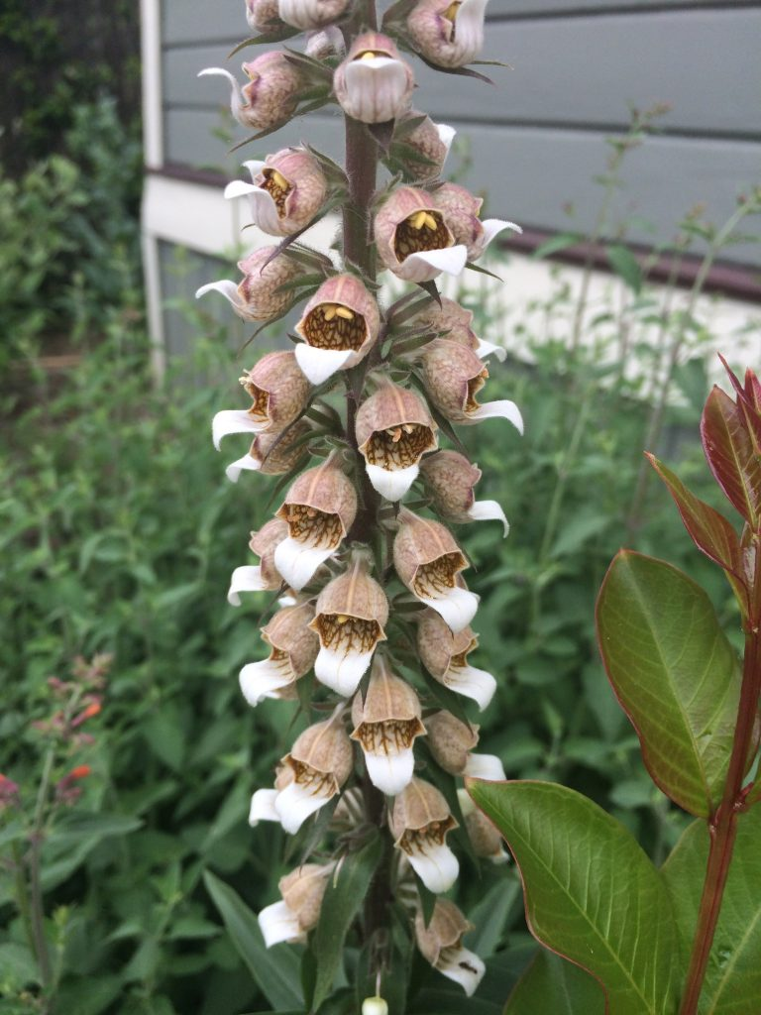
Digitalis lanata
Common name: Grecian Foxglove
Family: Scrophulariaceae
Part Used: Leaves

Slide 17
Constituents:
Digitalis lanata contains volatile oil, fatty matter, starch, gum, sugars and cardiac glycosides like lanatoside A, B, C and E. Lanatosides A and B are acetyl derivatives of purpurea glycosides A and B respectively. Hydrolysis of Lanatoside C yields digoxin, a crystalline active glycoside.

Slide 18
Uses:
It has gained much importance in recent years because of the less cumulative effect and three to four times greater activity than D. purpurea. They have the same actions as that of the D. purpurea. It is the commercial source of digoxin. Employed in the treatment of auricular fibrillation and congestive heart failure. Their use should always be supervised by a qualified practitioner since in excess they cause nausea, vomiting, slow pulse, visual disturbance, anorexia and fainting.

Slide 19
Toxicity:
Digitalis toxicity was one of the most common adverse drug reactions leading to hospitalization. Anorexia, nausea, and vomiting may be initial indicators of toxicity. Patients may also experience blurred vision, yellowish vision (xanthopsia), and various cardiac arrhythmias. Diarrhoea may be noted, as may abdominal discomfort, or pain, headache, malaise and sleepiness were common symptoms, neuralgic pain may be the earliest most severe, or the sole symptom.

Slide 20
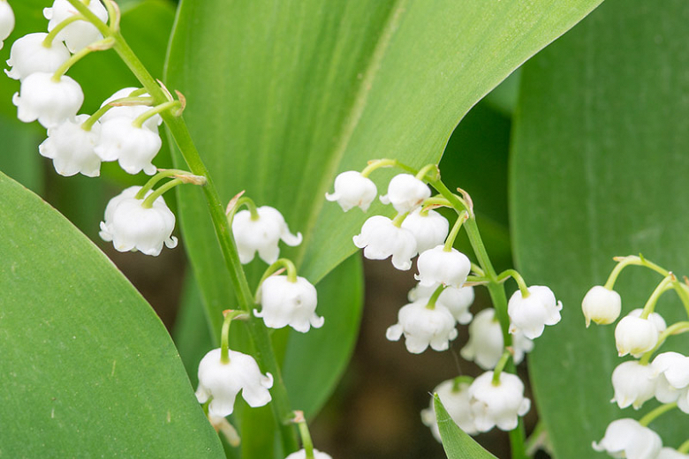
Convallaria majalis
Common name:
Lily of the Valley
Family: Liliaceae
Part Used: Leaf, flower (whole plant when flowering)

Slide 21
Constituents:
Cardioactive glycosides, over 30 different types (convallatoxin, convallatoxol, convallamarin, convallarin, and convallaric acid), saponins, flavonoids, asparagin.
Medicinal actions:
Cardioactive-tonic & stimulant, bitter, mild gastric tonic, anti-arrhythmic, hypertensive, diuretic, antispasmodic

Slide 22
Medicinal use:
Has similar but milder cardiac effects to Digitalis but without the toxic buildup. Exerts a positive inotropic and negative chronotropic action on the heart and is specific for congestive heart failure with edema. It is most indicated in bradycardic and/or arrhythmic forms of heart failure, although tachycardic hearts also respond to this herb. Mitral stenosis, mitral regurgitation and cor pumonale are especially good indications for the use of this plant.

Slide 23
Pharmacology:
Cardioactive glycosides, convallamarin & convallarin have stronger cardiac effects than Digitalis but a shorter half-life, and aglycones have a slower absorption rate.
Flavonoids stimulate vasodilation of coronary vessels but have a hypertensive effect systemically.
Asparagin is diuretic and helps drain fluids from edematous tissue.

Slide 24
Pharmacy: Tincture (1:5, 40%), 0.5-1.0 ml TID (8-15 drops). Infusion: 1 tsp/cup. Dried leaves: 60-200mg TID. Short term use best (4-6 weeks).
Toxicity: Signs of toxicity: nausea, vomiting, violent purging, cardiac arrhythmias, increased blood pressure, restlessness, trembling, mental confusion, extreme weakness, depression, collapse of circulation, and death. Monitor BP and edema. Berries are poisonous.

Slide 25
Contraindications: Should not be used in conjunction with anthraquinone glycoside containing plants.
Interactions: Anthraquinones, through their laxative effect, can deplete potassium levels, which will potentiate the cardioactive effect of cardioactive glycosides. This potentiation may result in cardiac arrhythmias.

Slide 26
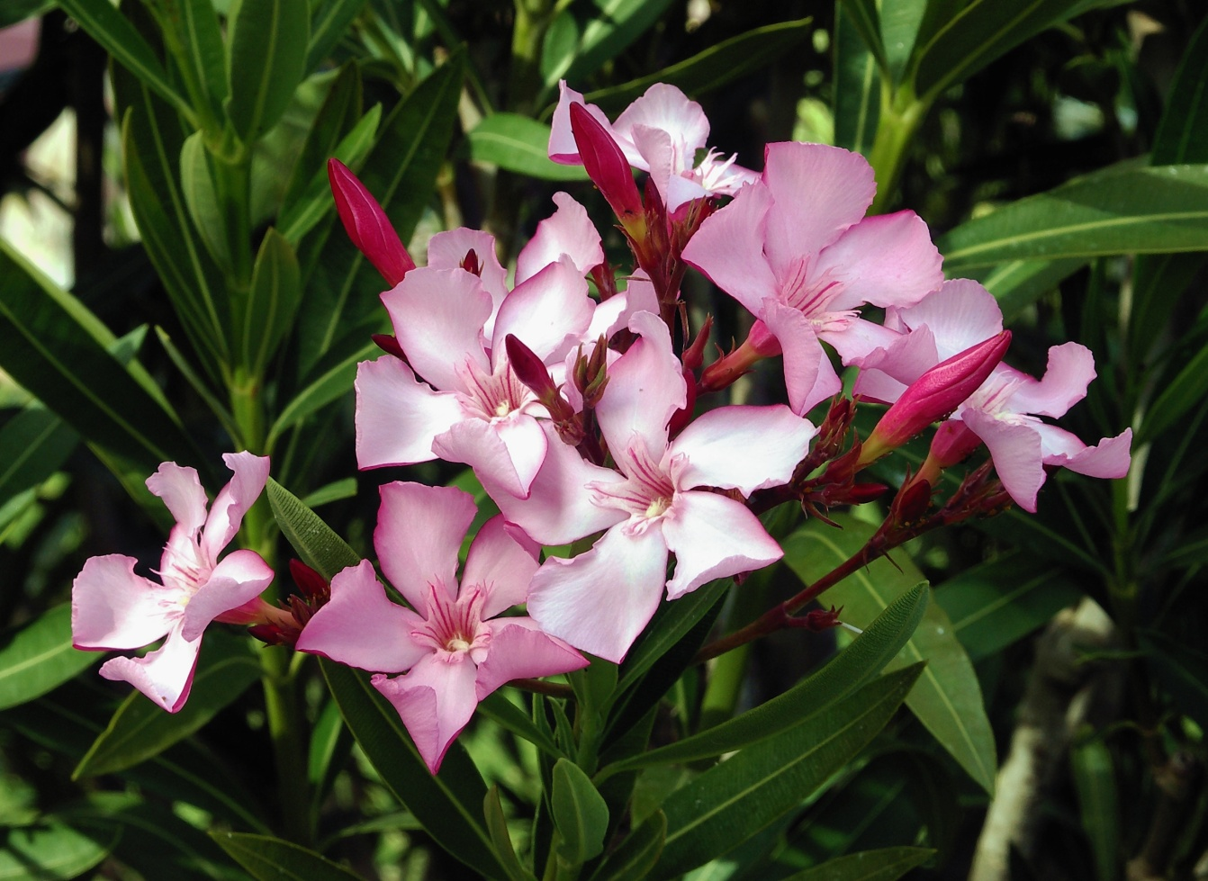
Nerium oleander
Common name:
Common oleander
Family: Apocynaceae
Part Used: seeds and leaves

Slide 27
Constituents:
The plant contains a number of related cardiac glycosides similar in activity to digitalis. The main glycosides are oleandrin, neriine, Cardenolides, gentiobiosyl, oleandrin and odoroside are also present. In addition, a variety of other pharmacologically active compounds, including folinerin, rosagenin, rutin and oleandomycin have been identified in the plant.

Slide 28
Pharmacology:
Nerium oleander possesses an effective antioxidant activity, which includes free radical scavenging and reducing power. The leaf, stem and root extracts of N. Oleander is an effective free radical scavenger and might be used as a natural source of potent antioxidant. Plant exposes Anti-inflammatory activity and Antimicrobial activity . The effect of ethanolic leaf extract was significant on bacterial strains such as Bacillus subtilis and Nyctanthes arbortristis. Anticancer activity.

Slide 29
Essential oil from the flowers of the oleander shows an antitumor activity on the cell lines, Ehrlich Ascites Carcinoma (EAC). Concurrent research has identified very positive immune-stimulating properties of the Nerium oleander plant.

Slide 30
Medicinal use:
Oleander has traditionally been used in the treatment of cardiac illness, asthma, diabetes mellitus, corns, scabies, cancer, and epilepsy, and in wound healing as an antibacterial/antimicrobial. However, limited quality clinical trials are available to support these uses.

Slide 31
Toxicity:
Oleander is extremely toxic and potentially fatal. Major toxicity reports include disturbances in heart rhythm and death. Signs of toxicity include severe nausea, emesis, abdominal pain, cramping, diarrhea, hyperkalemia, hypertension, lethargy, hepatotoxicity, and nephrotoxicity. Oleander intoxication can negatively impact the lungs, kidneys, spleen, and muscle tissue. Intoxication can occur from ingestion, or from inhalation of smoke from burned plants. Phytodermatitis caused by contact with oleander has been reported frequently.

Slide 32
Contraindications: Oleander is no longer considered safe due to extreme toxicity.
Interactions:
None well documented.

Slide 33
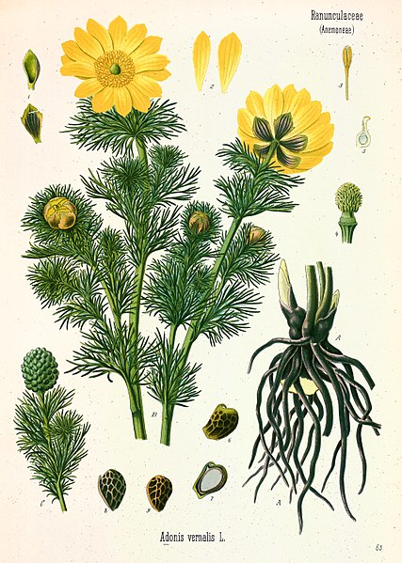
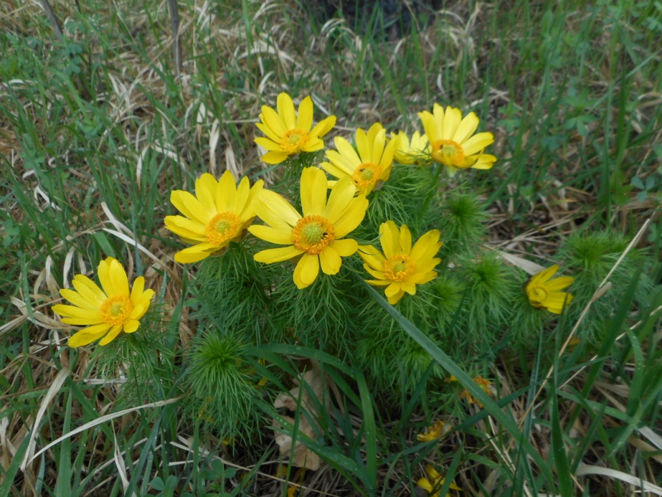
Adonis vernalis
Common name: pheasant's eye
Family: Ranunculaceae
Part Used: seeds and leaves

Slide 34
Constituents:
Since the first compound was isolated from Adonis plants in the early 19th century, more than 120 compounds have been isolated and identified to date. Fifty-four cardiac glycoside compounds were identified as active components. Additionally, flavones, carotenoids, coumarins and other compounds were also isolated and reported.

Slide 35
Pharmacology:
Plants of the genus, especially A. vernalis L. and A. amurensis Regel & Radde, their extracts and their active constituents possess broad pharmacological properties, including cardiovascular, antiangiogenic, antibacterial, antioxidant, anti-inflammatory and acaricidal activities, and exhibit both diuretic effects and effects on the central nervous system.

Slide 36
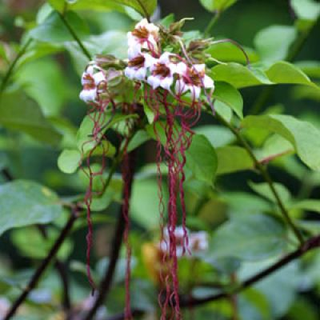
Strophanthus kombe
Common name: English 'arrow poison'
Family: Apocynaceae
Part Used: Dried, ripe seeds, deprived of their awns.

Slide 37
Constituents:
More than a dozen cardiac glycosides (cardenolides) have been isolated from Strophanthus kombe. Compared to Digitalis cardenolides, those of Strophanthus kombe are characterized by highly oxygenated aglycones. The glycosides are most abundant in the seed and are responsible for the activity as arrow poison and as cardiac and vascular stimulant. The seeds contain about 4 g/100 g of a mixture of glycosides called strophanthin-K. All compounds are highly toxic. The roots and fruits also contain considerable amounts of cardiac glycosides, while the leaves contain mainly resin.

Slide 38
Pharmacology:
The sole official use of Strophanthus in medicine is for its influence on the circulation, especially in cases of chronic heart weakness. As its action is the same as that of digitalis, although more likely to cause digestive disturbances (Many practitioners are of opinion that Strophanthus does not cause digestive disturbances), it is often useful as an alternative or adjuvant to the drug. Believed to have greater diuretic power, it is esteemed of greater value in cases complicated with dropsies.

Slide 39
Medicinal use: k-Strophanthin-β has a similar effect as Digitalis glycosides and causes a positive inotropic effect and electrophysiological changes in the heart.
It should be used with great care and under strict medical direction because of its strength and narrow pharmaceutical range. It may cause intense local irritation when administered by hypodermic injection. In urgent cases, the effects upon circulation can be obtained almost immediately by means of intravenous injection. It has stronger diuretic properties than other cardiac glycosides, which is of value in cases complicated by edema, but is also more likely to cause digestive disturbances

Slide 40
Pharmacy:
Of Extractum Strophanthi of the B.P., from 1/4 to 1 grain. This extract takes the place of a solid preparation and can be administered in pills and capsules, 1 grain being equal to 5 minims of the United States tincture. Of tincture of Strophanthus, B.P. and U.S.P., 5 to 15 drops.
Of Strophanthin, 1/200 of a grain.
The maximum daily dose should not exceed: For g-strophanthin, intravenously, 1/64 grain; by mouth, 1/2 grain. For k-strophanthin, intravenously, 1/40 grain; by mouth, 1/20 grain.

Slide 41
Toxicity:
The greatest caution should always attend the use of strophanthin, though, unlike digitalis, its effects are not cumulative.

Slide 42
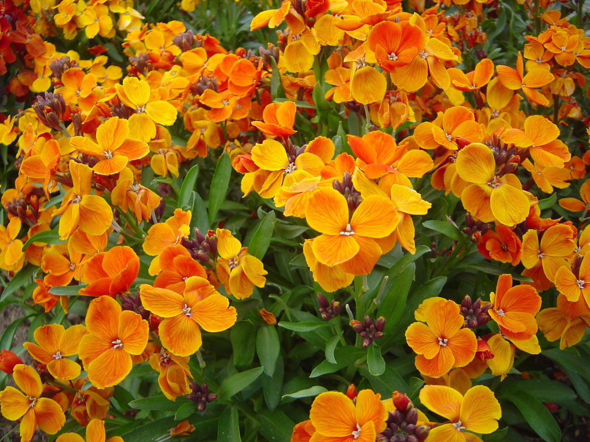
Erysimum cheiri
Common name: common wallflower
Family: Cruciferae
Part Used: The aerial part.

Slide 43
Pharmacology:
Glucosinolates: have an antimicrobial, relaxing and protective action on the vocal chords.
Vitamin C: antioxidant.
Mucilages: have a soothing effect.
Tannins: have an astringent and antiseptic effect.
Flavonoids: antioxidant.

Slide 44
Pharmacological activity
Cheiranthus cheiri possess remarkable activity against various physiological disorders. It was formerly used as diuretic. Smaller dose of Cheiranthus cheiri is cardiotonic supporting a failing heart in a manner similar to foxglove but in more than small dose it is toxic. Flowers possess cardiac stimulant and emmenagogue properties.

Slide 45
Seeds of Cheiranthus cheiri are tonic, diuretic, aphrodisiac and expectorant being useful in dry bronchitis. They are good remedy for fevers and eye injuries. Flowers are used in paralysis and impotence. The expressed juice of the seeds of Wallflower shows anti-bacterial activity against gram positive and gram negative bacteria.

Slide 46
Medicinal Action and Uses:
(In homoeopathic medicine a tincture of the whole plant has been found useful in the effects of cutting the wisdom tooth. The oil has a pleasing perfume if diluted, but in full strength a disagreeable odour. The alkaloid is useful acting on nerve centres and on the muscles.
Toxicity:
Toxic in overdose; contains cardioactive compounds. Should not be used with digitalis-like drugs.
Contraindications:
Not used during pregnancy

Slide 47
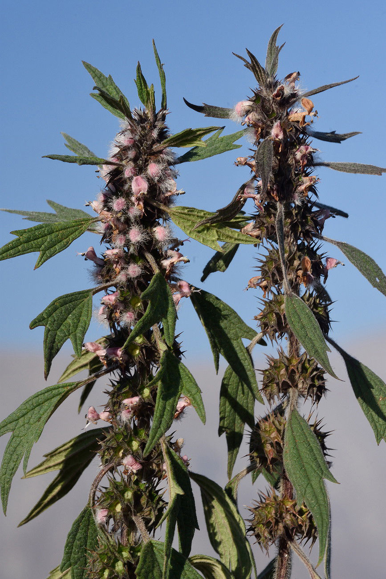
Leonurus cardiaca
Common name: Motherwort
Family: Lamiaceae
Part used: Aerial parts

Slide 48
Constituents:
Alkaloids (leonurine, betonicine and stachydrine), flavonoids, (apigenin, kaempferol, quercitin), iridoid glycosides such as leonuride, tannins, volatile oils, ursolic acid, vitamins A & C
Medicinal actions:
Sedative, nervine, nervous system tonic, antibacterial, anti-fungal, hypothryoid, diaphoretic, cardiotonic, anti-arrhythmic, vasoconstrictor, circulatory stimulant, hypotensive, hepatic, laxative, antispasmodic, mild uterine stimulant and emmenagogue.

Slide 49
Medicinal use:
Is most indicated in nervous debility with irritation and unrest. The hypotensive action is due to its vasodilatory effect, which also serves to increase circulation to the reproductive organs. Leonurus, as a gentle cardiotonic, is specific for cardiac disorders of nervous origin (i.e. tachycardia secondary to anxiety). Will also promote blood flow to female reproductive organs and balances hormones affecting the menstrual cycle as well as hyperthyroidism.

Slide 50
Pharmacology:
Alkaloids increase uterine contractions. Stachydrine is oxytocic & sedative. Leonurine is uterotonic, sedative, hypotensive, and cardioactive.
Glycosides are antiseptic, nervine, anti-spasmodic, and hypotensive.
Ursolic acid is anti-viral, anti-tumor, cytotoxic.

Slide 51
Pharmacy: Infusion: 1 tsp/cup water, 1-2 cups TID. Tincture (1:5, 45%), 4-6 ml TID. Capsules: 250 mg/cap; 1-2 cap TID.
Toxicity: No adverse effects expected within recommended doses.
Contraindicated: Pregnancy, menorrhagia.
Interactions: None reported. Theoretically interact with heart and cardiovascular therapy.

Slide 52
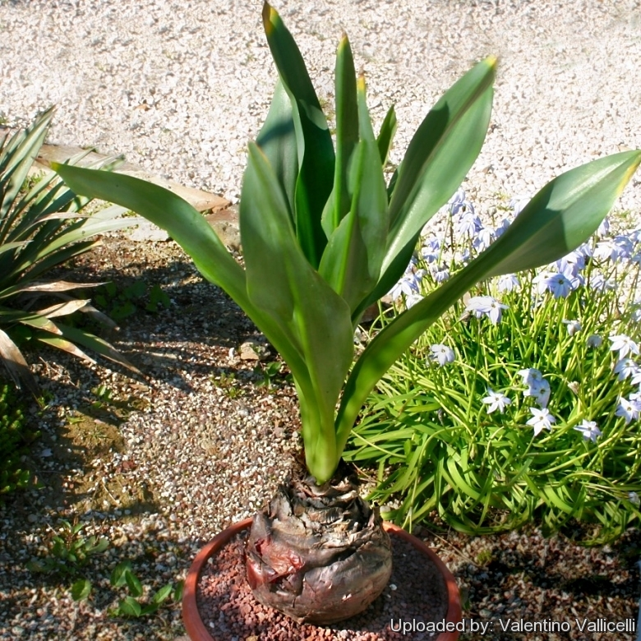
Urginea scilla
Common name: Squill
Family: Liliaceae
Part used: Bulb, cut into slices, dried and powdered.

Slide 53
Habitat
The Squill is found in dry, sandy places, especially the seacoast in most of the Mediterranean districts, being abundant in southern Spain, where it is by no means confined to the coast, and is found in Portugal, Morocco, Algeria, Corsica, southern France, Italy, Malta, Dalmatia, Greece, Syria and Asia Minor. In Sicily, where it grows most abundantly, it ascends to an elevation of 3,000 feet. Its range also includes the Canary Islands and the Cape of Good Hope.

Slide 54
Constituents
The chemical constituents of Squill are imperfectly known. Merck, in 1879, separated the three bitter glucosidal substances Scillitoxin, Scillipicrin and Scillin. The first two are amorphous and act upon the heart, the former being the more active; Scillin is crystalline and causes numbness and vomiting, expectorant principle.

Slide 55
Other constituents are mucilaginous and saccharine matter, including a Sinistrin, an Inulin-like substance, Calcium oxalate is also present, in bundles of long, acicular crystals, which easily penetrate the skin when the bulbs are handled, and causes intense irritation, sometimes eruption, if a piece of fresh Squill is rubbed on the skin.
The toxicity of Squills has more recently been ascribed to a single, bitter, non-nitrogenous glucoside, to which the name Scillitinis given, and which is the active diuretic and expectorant principle.

Slide 56
Medicinal Action
The Medicinal Squill was valued as a medicine in early classic times and has ever since been employed by physicians, being official in all pharmacopoeias.
It is mentioned by Theophrastus in the third century before Christ, and was known to all the ancient Greek physicians.
As a diuretic, it is frequently employed in dropsy, whether due to chronic disease of the kidneys or to the renal congestion consequent to chronic cardiac disease. Squill is not employed, however, when the kidneys are acutely inflamed. In the treatment of cardiac dropsy, Squill is frequently combined with digitalis.

Slide 57
Squill stimulates the bronchial mucous membrane and is given in bronchitis after subsidence of the acute inflammation. It is generally used in combination with other stimulating expectorants, its effects being thereby increased, and is considered most useful in chronic bronchitis, catarrhal affections and asthma. The tincture is administered combined with other expectorants, especially ipecacuanha and ammonium carbonate. Vinegar, Oxymel and Syrup of Squill are also common constituents of expectorant cough mixtures.

Slide 58
Medicinal Uses
It is largely used for its stimulating, expectorant and diuretie properties, and is also a cardiac tonic, acting in a similar manner to digitalis, slowing and strengthening the pulse, though more irritating to the gastro-intestinal mucous membrane. On account of its irritant qualities it is not administered in diseases of an acute inflammatory nature. It has also been given as an emetic in whooping-cough and croup, usually combined with ipecacuanha, but as an emetic is considered very uncertain in its action.

Slide 59
To prevent its too great action on the stomach, it is frequently combined with a portion of opium. With calomel, it forms a powerful stimulant of the urinary organs. (A pill containing 1 grain each of Squill, digitalis and calomel is popularly known as Niemeyer's pill.)

Slide 60
Toxicity:
In poisonous doses, Squill produces violent inflammation of the gastro-intestinal and genito-urinary tracts, manifested by nausea, vomiting, abdominal pains and purging, and, in addition, dullness, stupour, convulsions, a marked fall in temperature, enfeebled circulation and sometimes death.
The powdered drug and extracts made from it have been largely used as rat poisons and are said to be very efficacious, the red variety being preferred for this purpose, although there would not seem to be sufficient evidence of its superiority

Slide 61
Dosage
When given in substance, Squill is most conveniently administered in the form of pill. Also it can be use in the form of Vinegar of Squill, Liquid Extract of Squill, Syrup of Squill, Tincture of Squill,

Slide 62
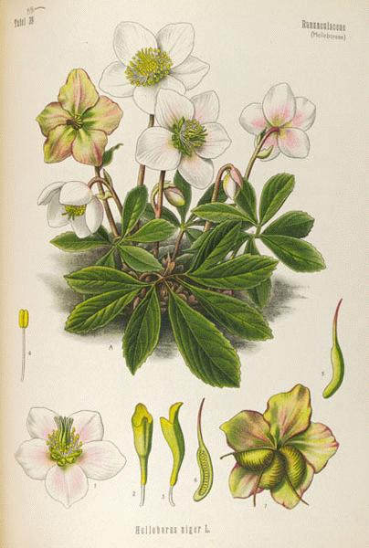
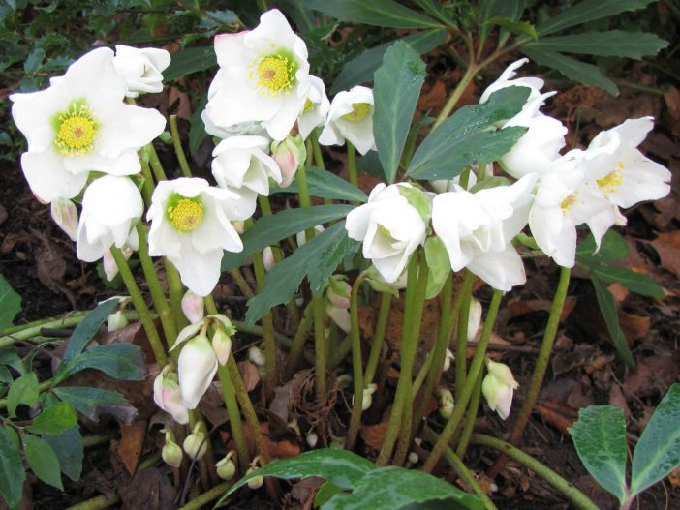
Helleborus niger
Common name: Christe Herbe. Christmas Rose. Melampode.
Family: Ranunculaceae
Part used: Rhizome, root.

Slide 63
Habitat
It is a native of the mountainous regions of Central and Southern Europe, Greece and Asia Minor, and is cultivated largely in this country as a garden plant. Supplies of the dried rhizome, from which the drug is prepared, have hitherto come principally from Germany.

Slide 64
Constituents
Two crystalline glucosides, Helleborin and helleborcin, both powerful poisons. Helleborin has a burning, acrid taste and is narcotic, helleborcin has a sweetish taste and is a highly active cardiac poison, similar in its effects to digitalis and a drastic purgative. Other constituents are resin, fat and starch. No tannin is present.

Slide 65
Medicinal Action and Uses
The drug possesses drastic purgative, emmenagogue and anthelmintic properties, but is violently narcotic. It was formerly much used in dropsy and amenorrhoea, and has proved of value in nervous disorders and hysteria. It is used in the form of a tincture, and must be administered with great care.
Applied locally, the fresh root is violently irritant.

Slide 66
Preparations
Fluid extract, 2 to 10 drops. Solid extract, 1 to 2 grains. Powdered root, 10 to 20 grains as a drastic purge, 2 to 3 grains as an alterative. Decoction, 2 drachms to the pint, a fluid ounce every four hours till effective.
A tincture of the fresh root of H. foetidus is used in homoeopathy.

